Slide 1
A Dog In School
A presentation for parents

Slide 2
Bailey
Belongs to Mrs Cook

Slide 3
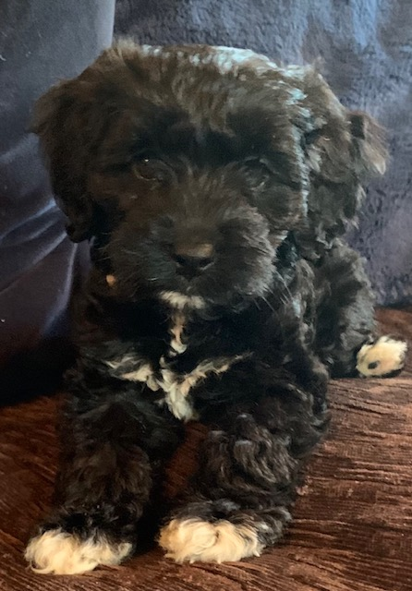
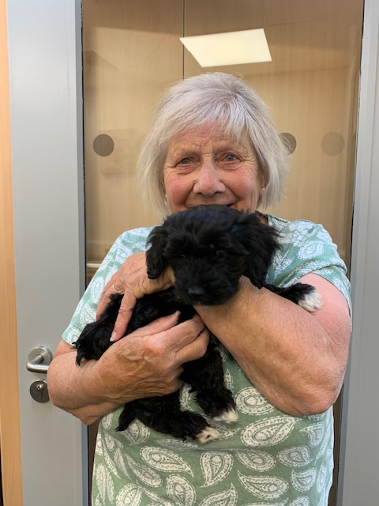
Bailey has been in school since he was 8 weeks old and loves being around adults, children and other dogs!
He was named after Mrs Bailey, who retired after 40 years as a Road Crossing Patrol

Slide 4
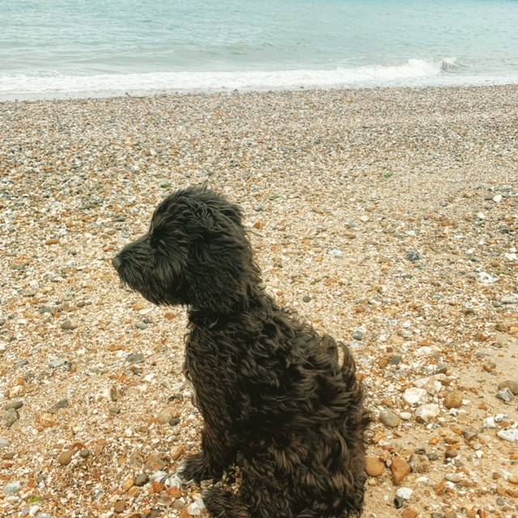
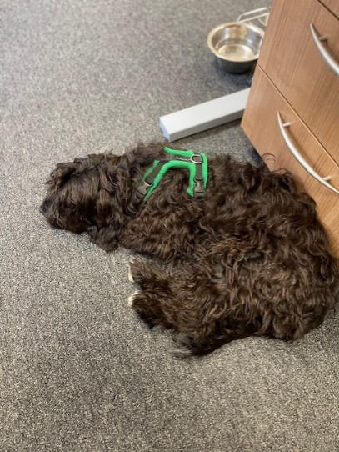
Bailey is fully vaccinated, is regularly wormed and medicated for fleas and ticks and is insured to be in school.
Bailey is going to puppy training classes and has almost completed Foundation 1.
As soon as he is ready, Bailey will be assessed as a Therapy Dog.
He loves running free along the beach every morning, greeting children and their families at the school gates and taking long naps in the office!
He loves it when children take him for a walk during the school day!

Slide 5
Research

Slide 6
Specific Research Results
Research shows improved reading levels particularly in children who are reluctant readers or making slower than expected progress in reading.
Research has measured the stress hormone (cortisone) in children when they are reading aloud, presenting to the class or taking tests and without exception in all children (and the staff) less cortisone was measured when the dog was present!
Research has identified that classrooms with dogs are quieter and calmer when the dog is present.
https://www.youtube.com/watch?v=EAO8i7s1uWU

Slide 7
Benefits

Slide 8
Other Benefits Noticed By Schools With Dogs
calming effect on pupils, particularly those with behavioural or learning difficulties
improved behaviour and concentration, reduced stress and improved self-esteem
encouraging expression and participation in more withdrawn children
fostering a sense of responsibility
motivating pupils to think and to learn, as children have a high level of natural interest in, enthusiasm for and enjoyment of animals
encouraging respect and thereby improving pupils' relationships with each other, parents and teachers
teaching children to nurture and respect life
providing a feeling of safety, security, comfort and love when required
helping the most vulnerable children to achieve
helping children build confidence in reading

Slide 9
How Could It Work For Us?

Slide 10
Taking part in guided reading work
Supporting/motivating children during 1:1 sessions
Providing comfort to a distressed child (fallen over at playtime, argument with friend etc.)
Accompanying children to see visitors that they may find stressful (police, social workers, school nurse)
Accompanying children outside if they can’t take part in PE e.g. children with a broken arm can still walk the dog!
A fun friend to play with …. especially if they do not have a pet at home!

Slide 11
Listening to readers or listening to stories children have written.
A role model: sits quietly, listens carefully, gentle and kind to everyone, eats healthy snacks, takes regular exercise, drinks water, waits his turn, shares.
Providing opportunities for children to be responsible.
A reward for good behaviour/effort.
Accompanying children to the library
Supporting work on social skills and self esteem or as the ultimate confidential friend ……. he won’t share your secrets!
…….. and so the list goes on, we can always rely on our staff team to use opportunities creatively.

Slide 12
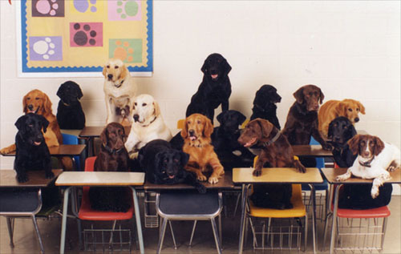
Bailey will be introduced to children slowly, senstively and at the children’s own pace. A risk assessment is available to view.

Slide 13
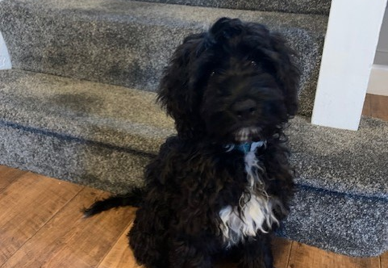
“I can’t wait to meet you!”
Bailey, Aged 7 Months

